Slide 1
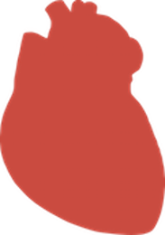
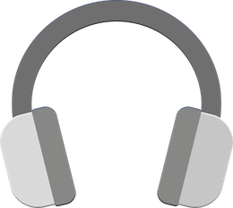
“Focus your attention” - Task
During the following experiment you will see one of two possible symbols for blocks of 20 seconds each:
A heart or a headphone.
‘→’ to read the next page

Slide 2
Whenever the heart symbol is shown, concentrate on you own heartbeat for the entire duration the image is on the screen!
Please DO NOT feel your pulse or change your breathing deliberately. Please DO remain seated still and fixate the symbol in front of you.
‘←’ to read the previous page
‘→’ to read the next page

Slide 3
Whenever the headphones are shown, concentrate on the white noise sound stimulus in your headphones for the entire duration the image is shown on the screen!
Please DO remain seated still and fixate the symbol in front of you.
‘←’ to read the previous page
‘→’ to read the next page

Slide 4

Whenever you see the fixation cross you can relax and think about whatever you like.
This is your break between the focusing tasks, so maybe you want to take a deep breath so you’re ready when it starts again.
Please also try not to take the eyes of the fixation cross.
‘←’ to read the previous page
‘→’ to read the next page

Slide 5
Further: We are interested to test your experience and your associations while you focus on your heart or the sound on your headphones.
We will therefore ask you a question after every attention block about what you have heard, what youre associations were with it etc.
These questions always relate to the last block you just experienced (either heart or sound). Please answer quickly and “out of your belly” – without thinking too much or too long about it.
It is therefore very important that you try hard to focus your attention during each block for the entire duration of the block.
‘←’ to read the previous page
‘→’ to read the next page

Slide 6
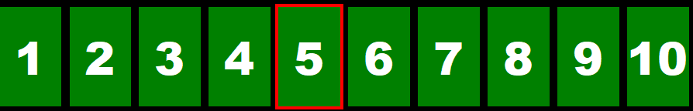
Every question can be answered on a scale from 1 (not at all) to 10 (very much).
You indicate your response by choosing the appropriate number for you.
For example:
In these questions, please use the arrow key left (←) or right (→) to move the cursor to the number that seems appropriate to you.
Use the down arrow key (↓) to validate the response.
‘←’ for the previous page
‘→’ for the next page

Slide 7
Everything clear? Any questions ?
We now set the volume and do one example each and after that we would start.
‘↓’ to start the example

Slide 8

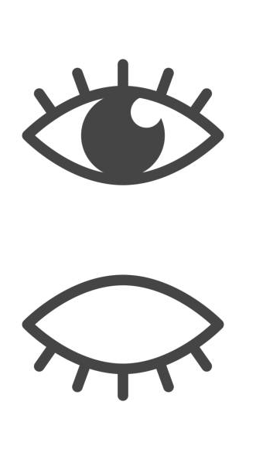
And please remember (because of the EEG):
Move eyes or blink as little as possible
Move as little as possible
‘↓’ to start

